Slide 7
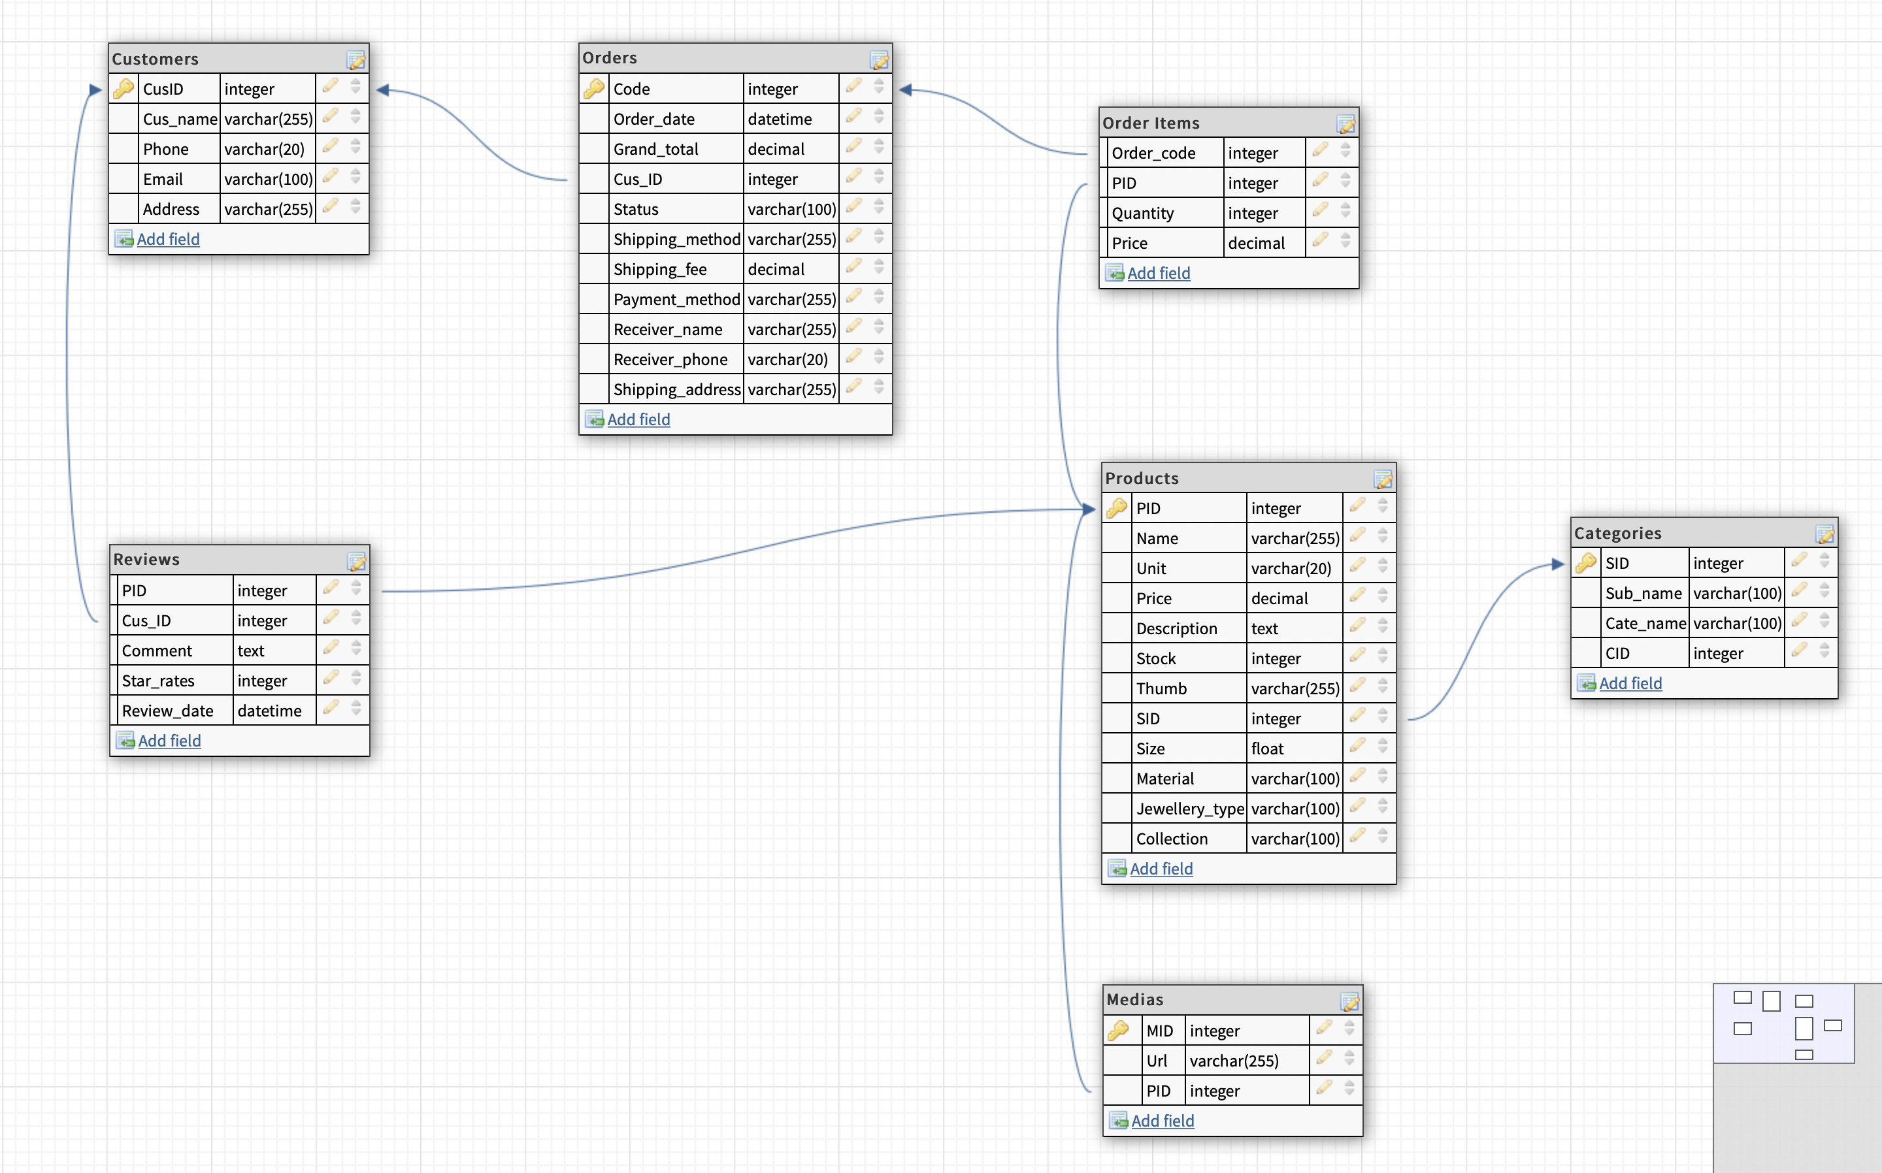
D b d I a g r a m

Slide 9
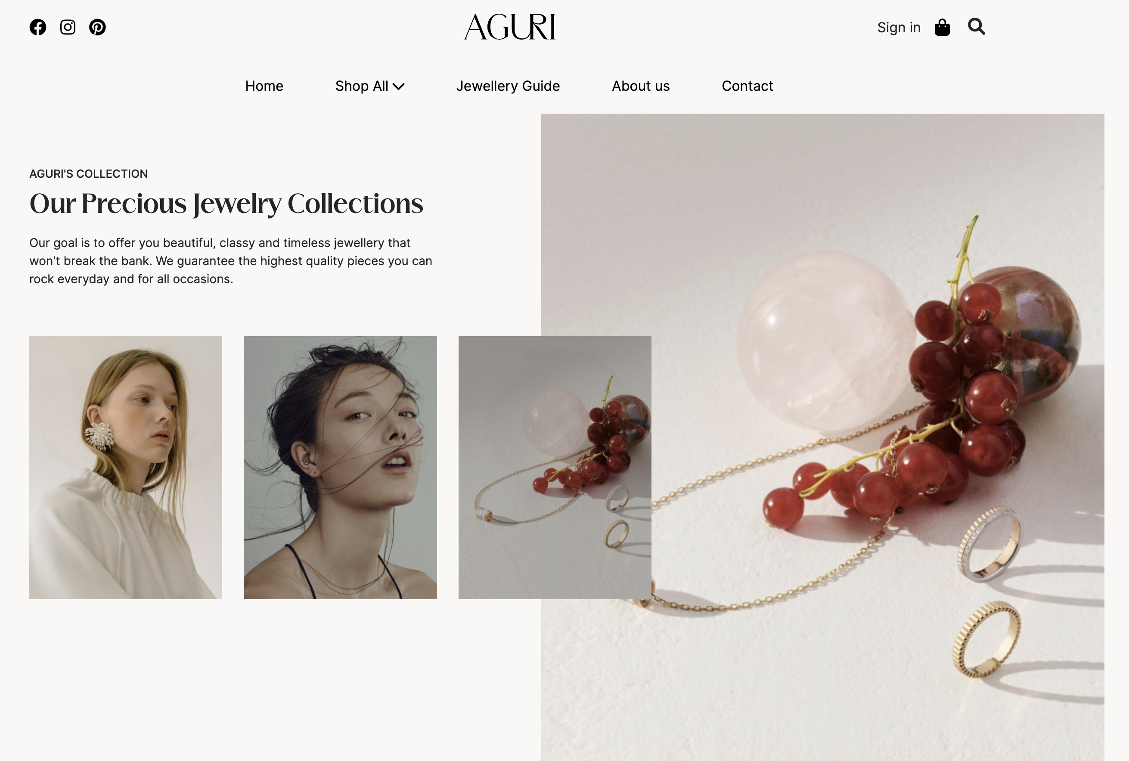
D I s p l a y

Slide 10
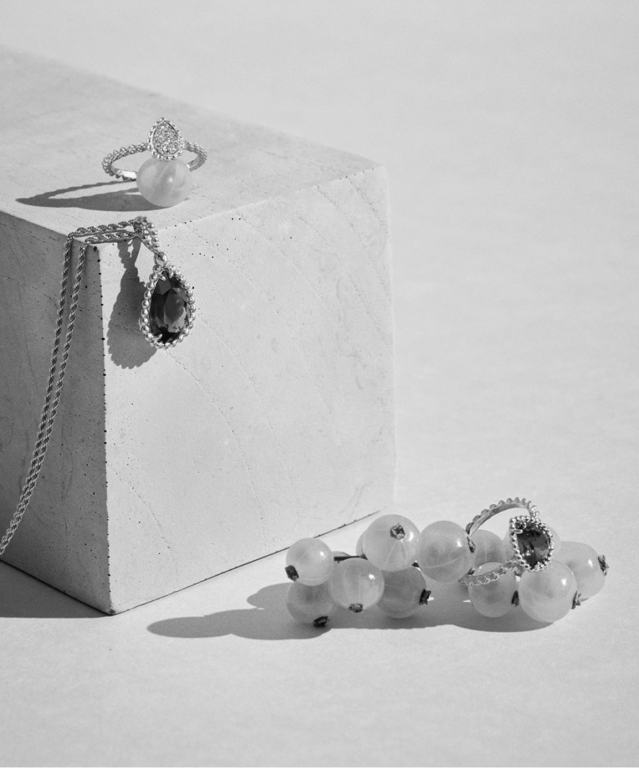
Functions
AGURI
Product
About us
Contact us
Our showroom
Follow us
Guide

Slide 11
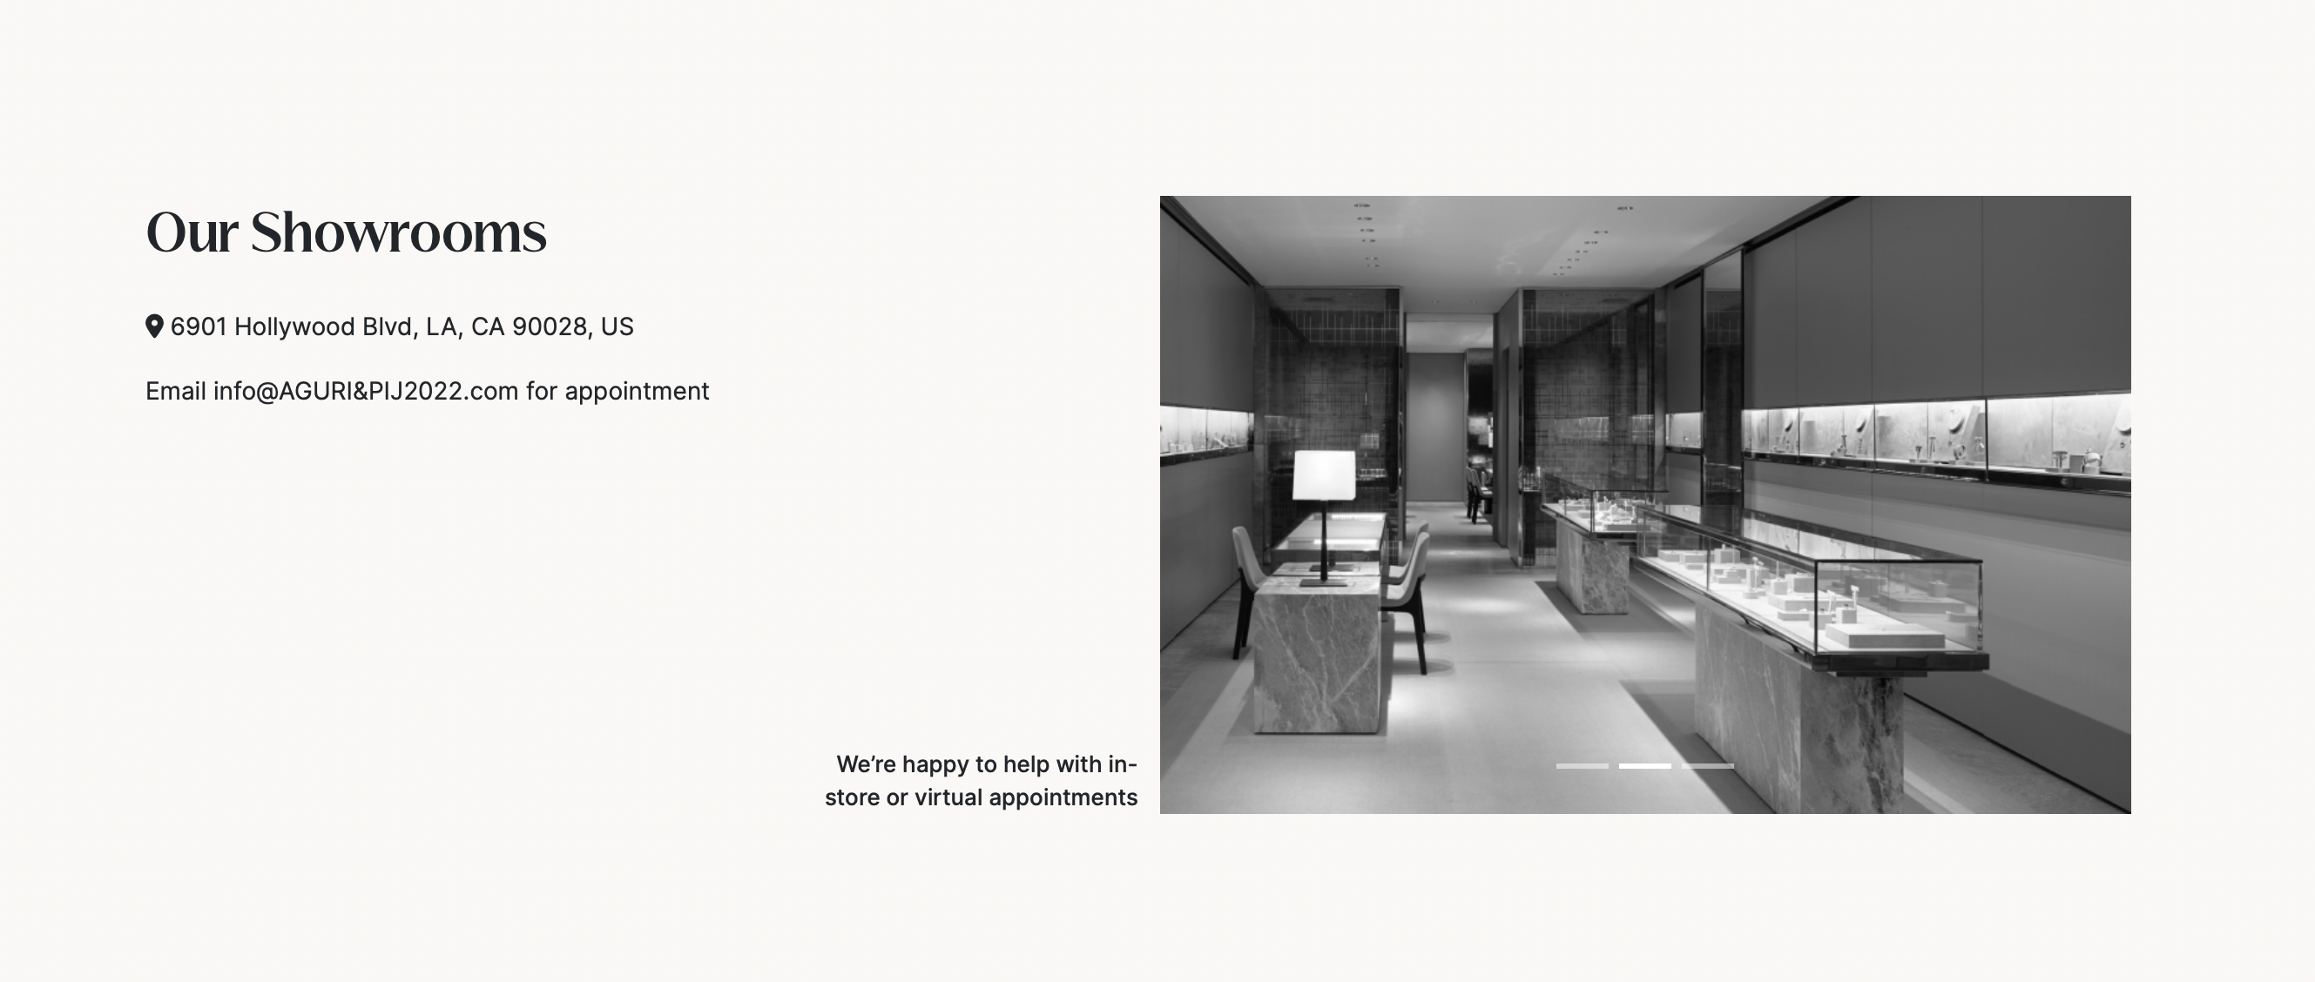
Functions

Slide 12
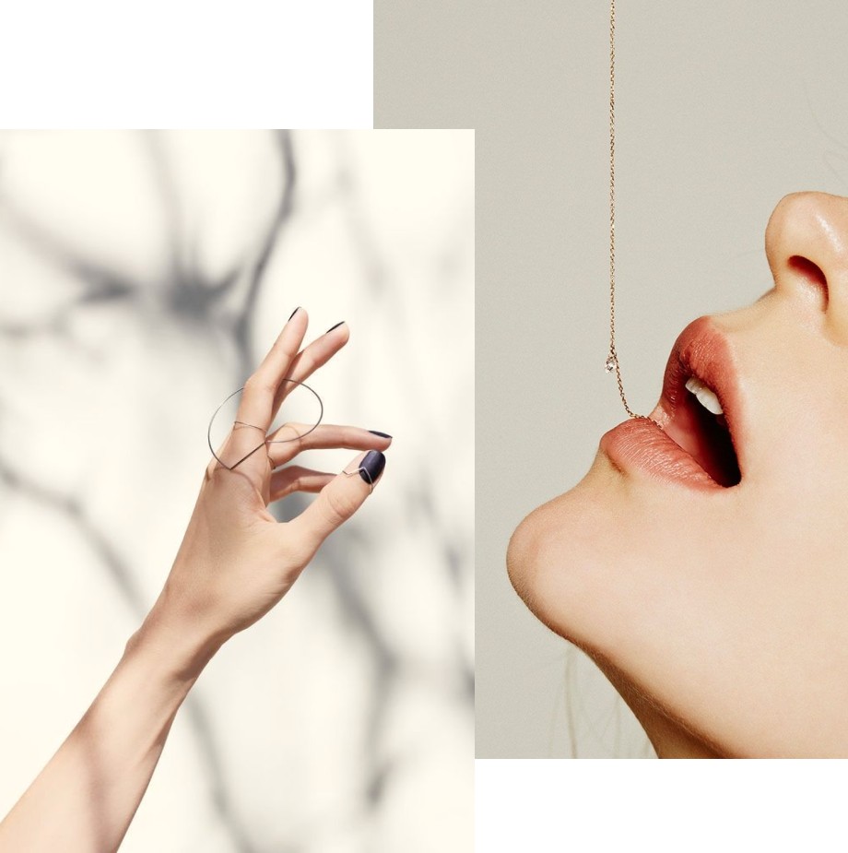
Categories & sub-categories
New arrivals
Best seller
PRODUCTS

Slide 13
Products
Search
Quick view
Compare
Add to Cart
Detail
Filter

Slide 14
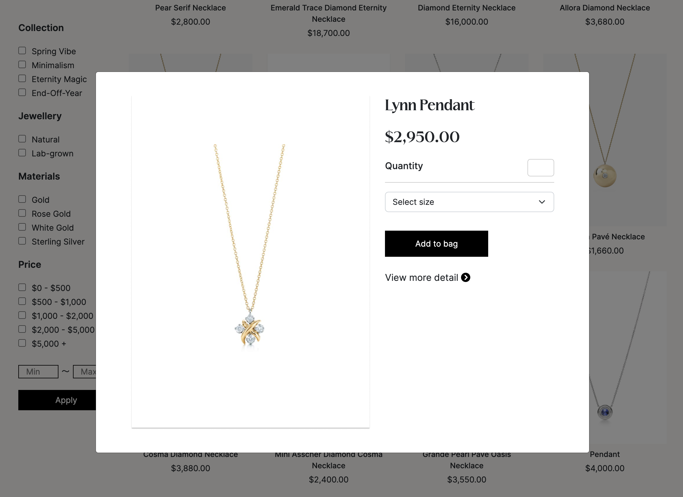
Quick view
The quick view feature makes it easier for your customers to view the key product information such as features, images, and variants by displaying a brief overview without heading to the product details page.

Slide 15
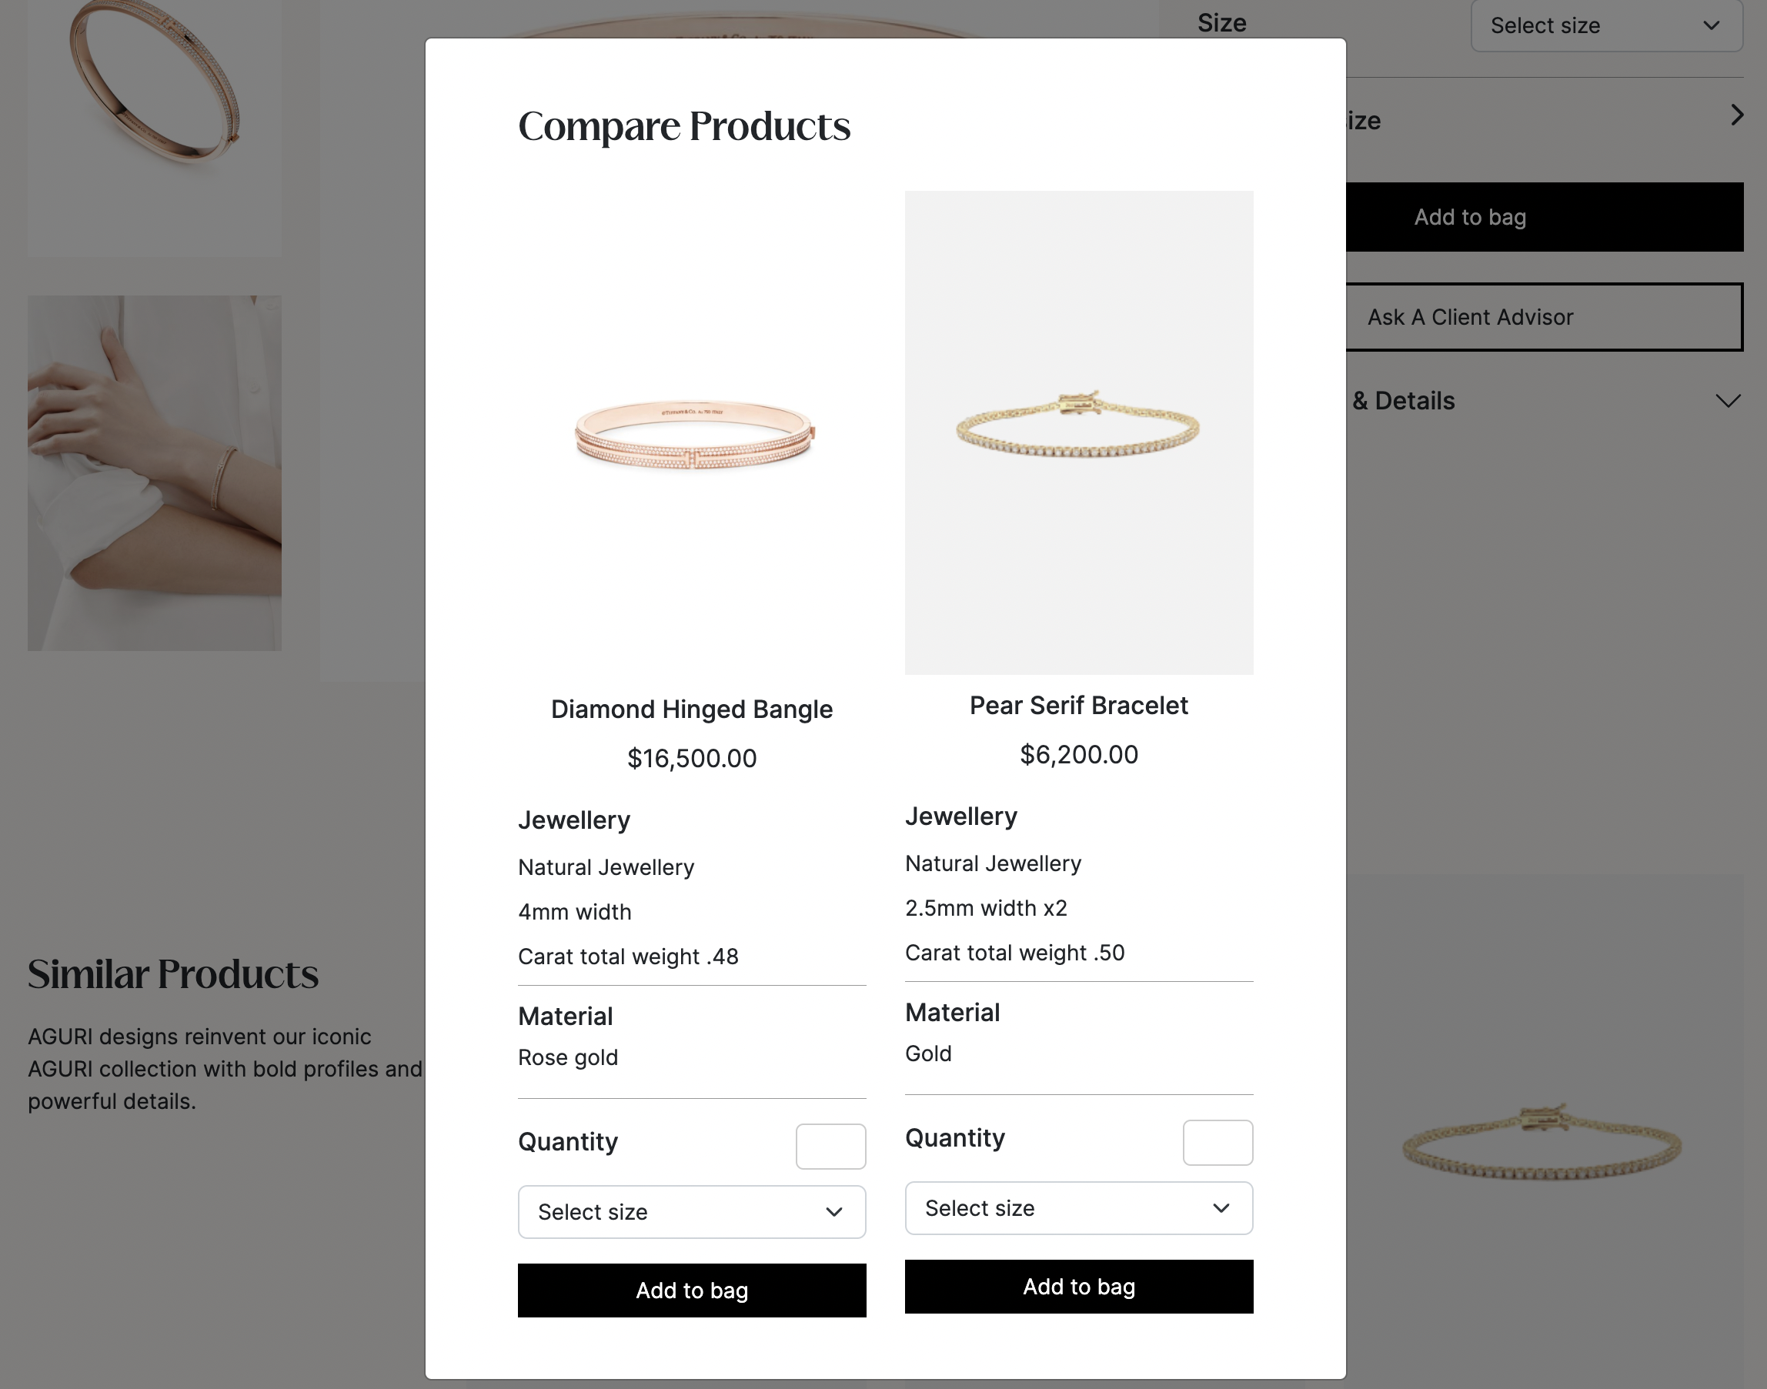
Compare products
The compare products feature makes it easier for your customers to compare the similar product information such as material, image, and variants by displaying overview without heading to the product details page.

Slide 16
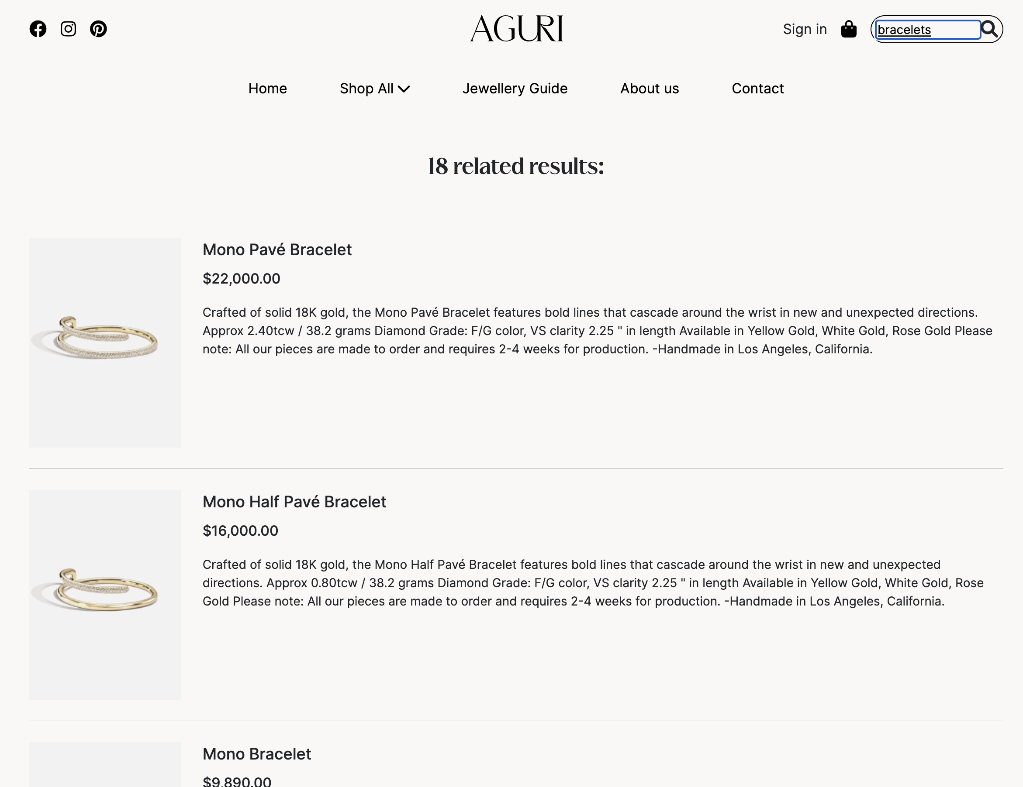
product searching
Searching allows customers to find certain products that satisfy a set of criteria. In the Aguri Brand, we implemented searching simple. Simple searches allow a customer to search the catalog for keywords.

Slide 17
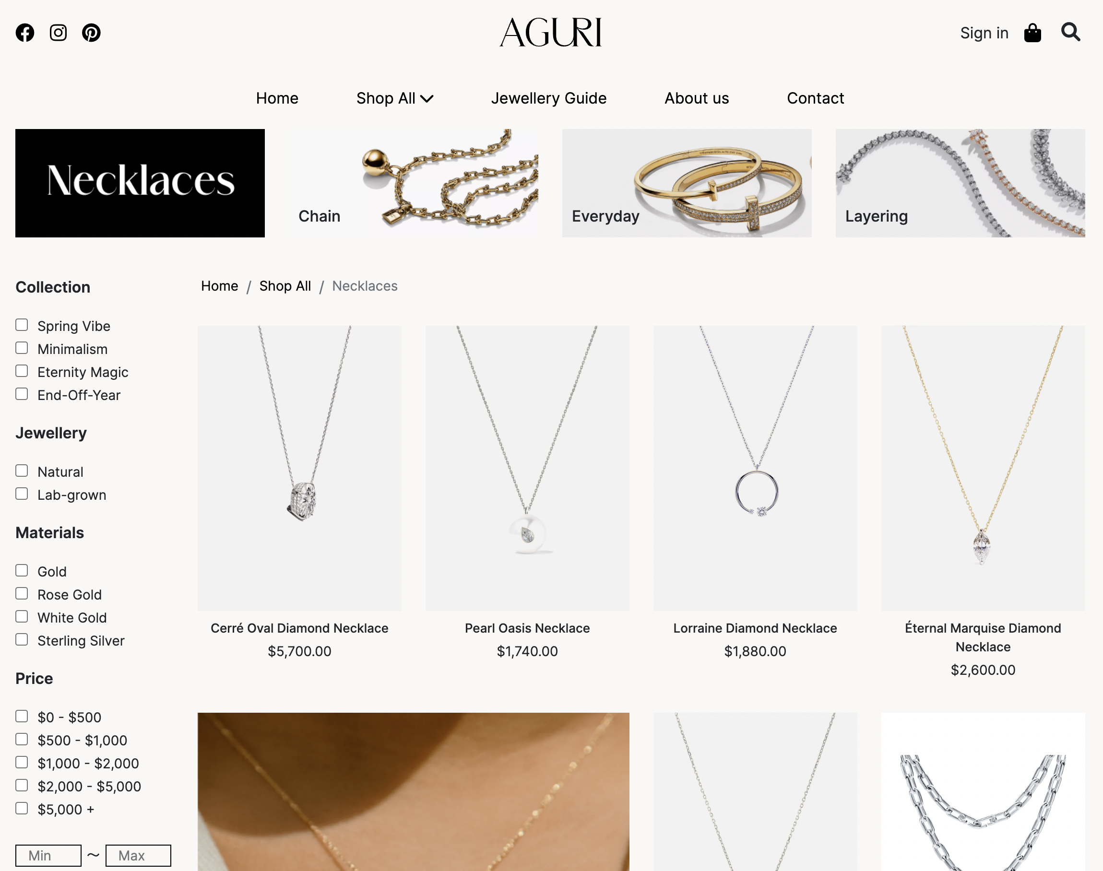
Product filtering
Product Filtering allows shoppers to refine product searches based on multiple attributes like jewellery, material, price... Using filters on your storefront can make it easier for shoppers to navigate products by allowing them to search the way they want to.

Slide 18

Add-in function
About Natural & Lab-grown Jewellery
Jewellery Characteristics
Jewellery Insurance
Jewellery care
…

Slide 19
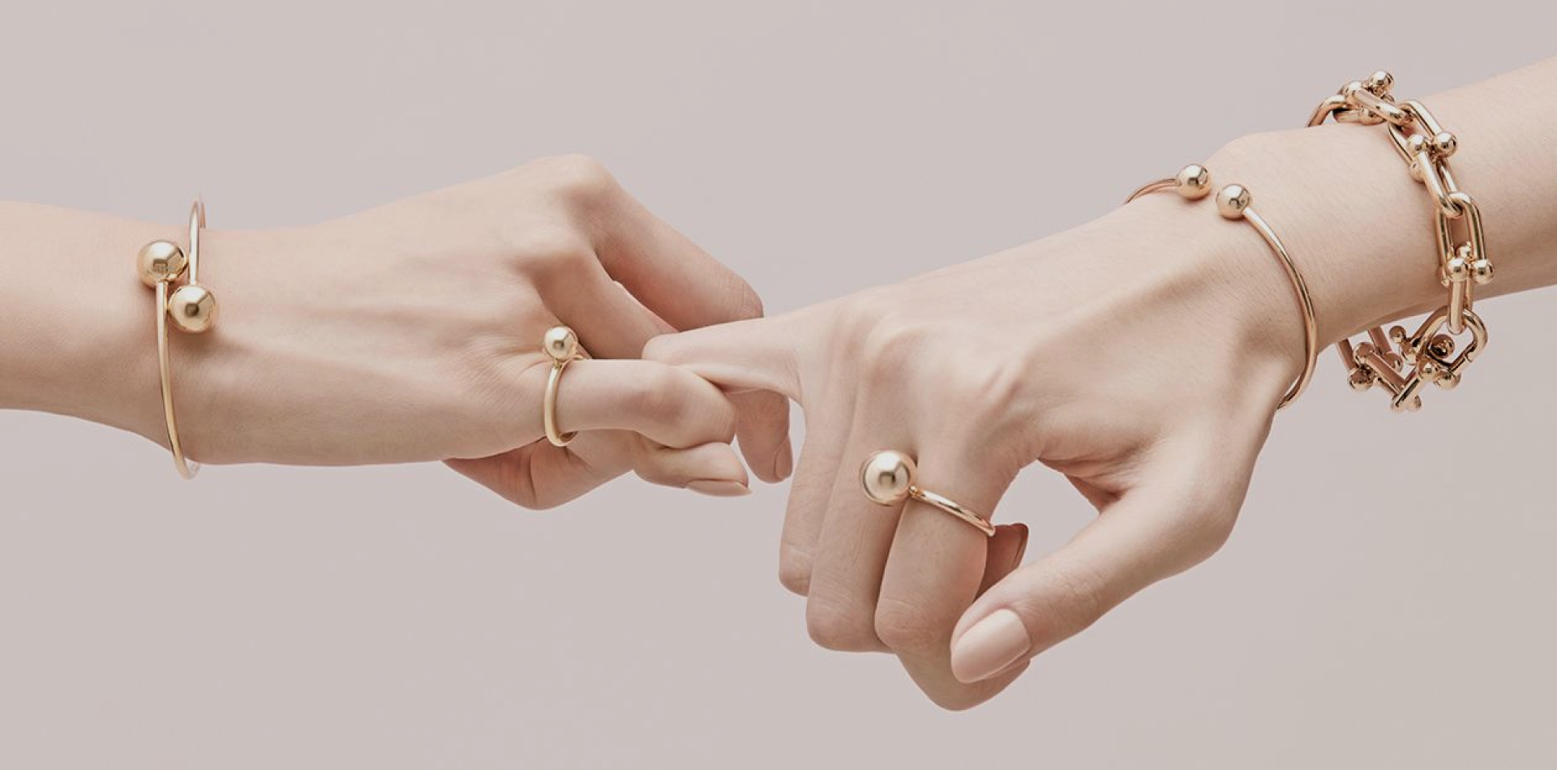
Customers
Sign-up
Sign-in
Buy products
Review
Feedback

Slide 20

shopping
Add to bag
+/-
View back
Check
Check out
Information
Tracking order

Slide 21
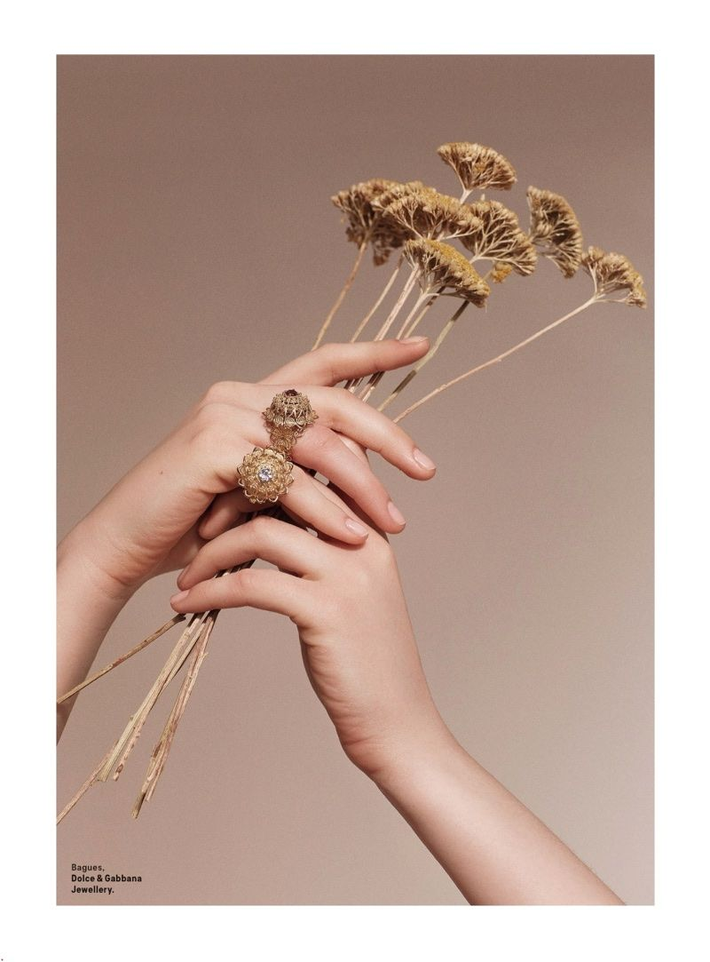
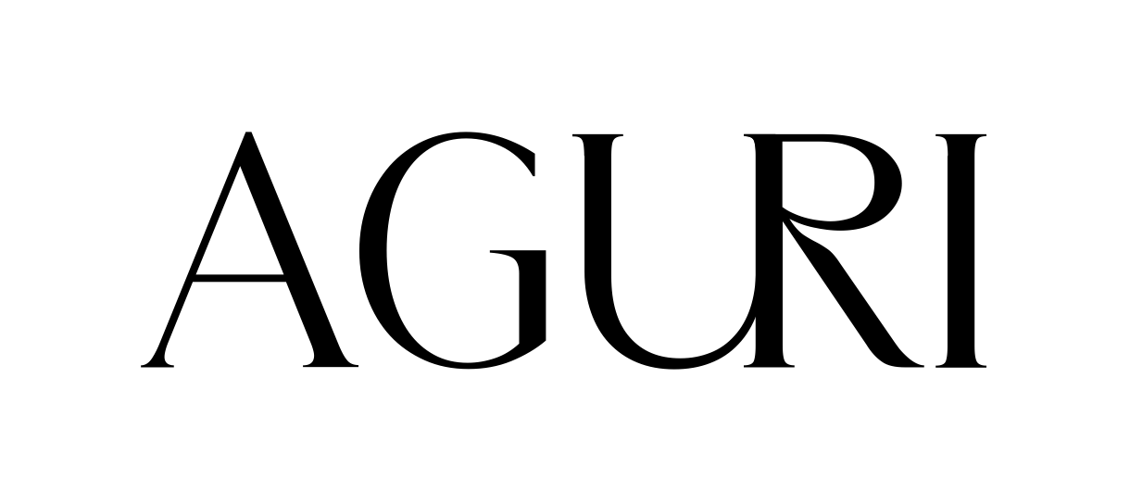
So glad to see you here!

